Slide 1

PES UNIVERSITY, BANGALORE
April 2022: IN SEMESTER ASSESSMENT(ISA) BTECH IV SEMESTER
UE20MA251 – LINEAR ALGEBRA
PROJECT/SEMINAR
Session: Jan-May 2022
Branch : Computer Science and Engineering
Semester & Section: Semester IV Section B
Sl. No. | Name of Student | SRN | Marks Alloted (Out of 10)
1. | Anushka Siri Raghunandan | PES1UG20CS073
2. | Devika S | PES1UG20CS123
3. | Praneetha B | PES1UG20CS106
4. | Vaishnavi V B | PES1UG20CS902
Name of Course Instructor: Prof. Chaitra G P
Signature of Course
Instructor(with Date) : _______________

Slide 2
LINEAR ALGEBRA IN GENETICS
TEAM MEMBERS:
Anushka Siri Raghunandan (PES1UG20CS073)
Vaishnavi V B (PES1UG20CS902)
Devika S (PES1UG20CS123)
Praneetha B (PES1UG20CS106)

Slide 3
TABLE OF CONTENTS
Pre-requisites
Linear Algebra Applications in Genetics
Part A: Inheritance
Part B: Genetic Algorithms
Part C: DNA Sequencing
Acknowledgement

Slide 4
SOME PREREQUISTES…
GENE: Basic physical and functional unit of hereditary
GENETICS: Branch of biology in which we study about genes, genetic variation, and heredity in organisms
GENOTYPE: A genotype is the genetic arrangement that makes up the traits that an organism inherited from its parents
Notes:
Genetics is the study of inheritance, or transmission of traits from one generation to another.

Slide 5
HOW DOES LINEAR ALGEBRA FIT IN?

Slide 6
LINEAR ALGEBRA APPLICATIONS
Predict the DNA sequence
Inheritance of a gene from parents and predict the outcome effect on the child
Genetic algorithms

Slide 7
PART A - INHERITANCE

Slide 8
BACKGROUND
Gregor Mendel(father of Genetics) – trait inheritance by controlled breeding
Jared Kirkham – genotypic distribution of flower population in nth generation considering autosomal inheritance
John Gallego, Sunit Kambli and Daniel Lee worked on the probability of the peppered moth to survive and predict genotype distribution in future generation

Slide 9
BACKGROUND
If distribution of present generation is knownthen we can use a transition matrix A of the population to find the genotype distribution of the future generation
Genotype distribution of nth generation – found using linear algebra concepts

Slide 10
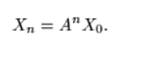
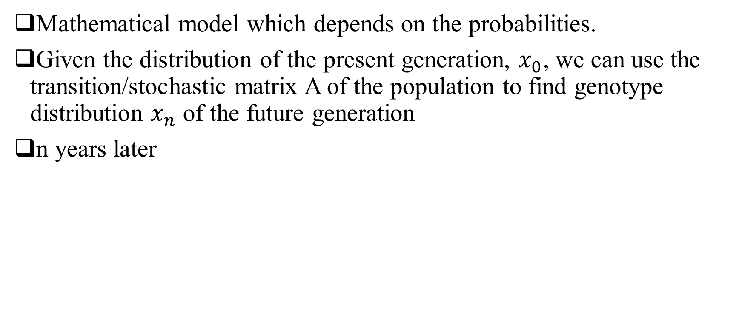
MARKOV’S CHAIN
Mathematical model which depends on the probabilities.
Given the distribution of the present generation, $x_{0}$, we can use the transition/stochastic matrix A of the population to find genotype distribution $x_{n}$ of the future generation
n years later

Slide 11
AUTOSOMAL(Dominant) INHERITANCE
Each inherited trait is assumed to be governed by a set of two genes
Designated by: A(dominant trait) and a(recessive trait)
Example: Eye color(AA – brown; aa – blue)
Aa will result in brown eyes and not a mix of blue and brown

Slide 12
PROBLEM 1
Parent 1 – AA(brown eyes)
Parent 2 – aa(blue eyed)
Offsprings – all Aa(brown eyed)
A A
a
a
Aa | Aa
Aa | Aa

Slide 13
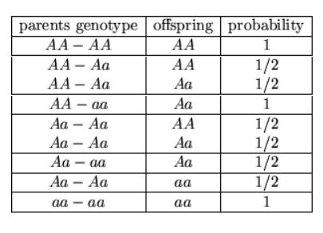
PROBLEM 1
Parent 1: AA
Parent 2: Aa
Offspring: AA(1/2) and Aa(1/2)
Probability table:

Slide 14
PROBLEM 1
Question: Find the probability of a certain genotype after n years
Professor Vetar, at UC Davis, discovers that cows with genotype AA can produce a better quality milk than other genotypes. Professor Vetar is interested in discovering the fraction of offspring cows with genotype AA. If the professor choses to cross only genotype AA with other genotypes, find the probabilities of the offsprings being AA, Aa, aa
3 cases
AA – Aa
AA – Aa
AA – aa

Slide 15
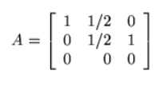
PROBLEM 1
Result of the breeding:
PARENT GENOTYPE |  |  | OFFSPRING GENOTYPE
AA - AA | AA - Aa | AA - aa
1 | 0.5 | 0 | AA
0 | 0.5 | 1 | Aa
0 | 0 | 0 | aa
Stochastic matrix:

Slide 16
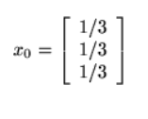
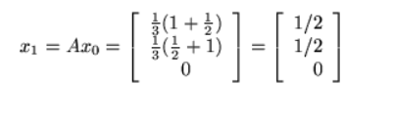
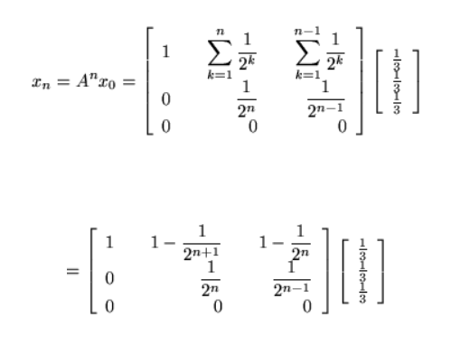
PROBLEM 1
Initial matrix:
One year later,
n years later,

Slide 17
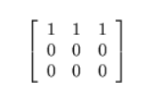
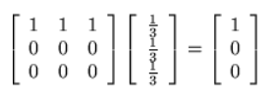

PROBLEM 1
As n gets larger $A^{n}$ approaches
So $x_{n}$ will be
Solve this using diagonalization

Slide 18
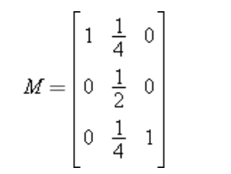
PROBLEM 2
We can modify Problem 1 so that instead of each plant being fertilized with one of genotype , each plant is fertilized with a plant of its own genotype. Using the same notation as in Problem 1, we then find
Solve using this M matrix to get the values

Slide 19
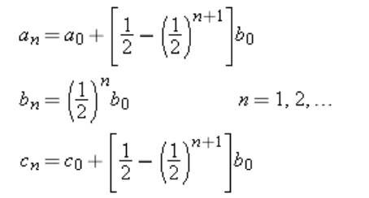
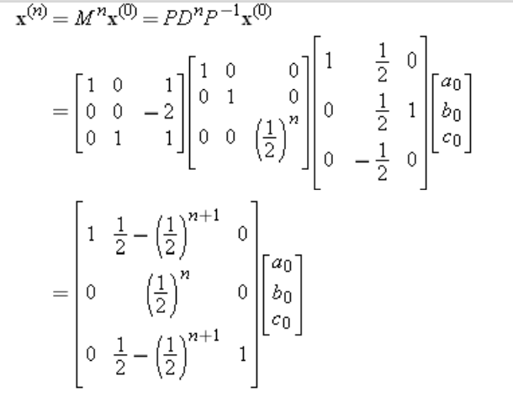
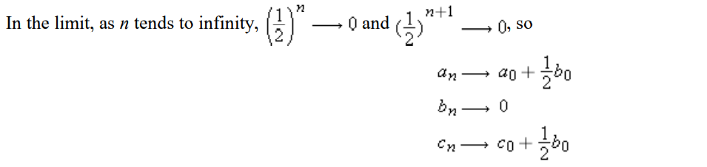

PROBLEM 2
So,
If,
$a_{0}$ - for AA
$b_{0} −for Aa$
$c_{0} −for aa$
Then,
And,

Slide 20
AUTOSOMAL(Recessive) INHERITANCE
A – dominant gene
a – recessive gene
AA – normal
Aa – carrier
aa – affected
Ex: Cystic fibrosis

Slide 21
PROBLEM 3
Question: Suppose that an animal breeder has a population of animals that carries an autosomal recessive disease. Suppose further that those animals afflicted with the disease do not survive to maturity.
Soln: Always mate a female, regardless of her genotype, with a normal male
All future offspring will either have a normal father and a normal mother (AA – AA matings) or a normal father and a carrier mother (AA – Aa matings). There can be no Aa – aa matings since animals of genotype aa do not survive to maturity.

Slide 22
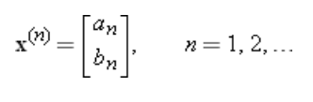
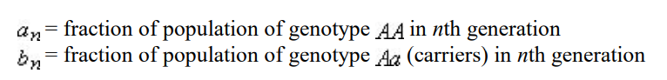
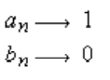
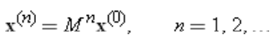
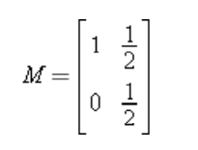
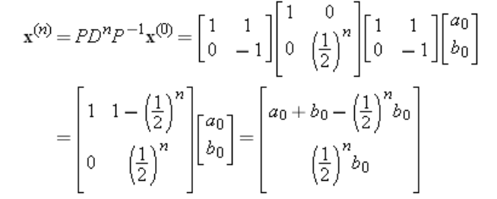
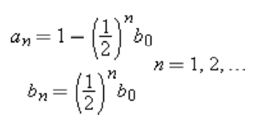
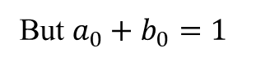
PROBLEM 3
Determining future generation fractions,
Stochastic matrix,
Since we know the necessary parameters,
As n->infinity
But $a_{0}+b_{0}=1$

Slide 23
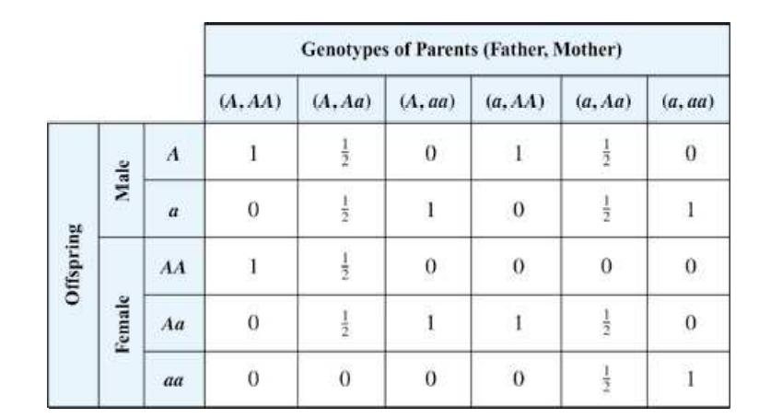
X – LINKED INHERITANCE
Male possesses one X chromosome(A or a)
Female possesses two X chromosome(AA/Aa/aa)
Inheritance: A male offspring receives one of his mother's two genes with equal probability, and a female offspring receives the one gene of her father and one of her mother's two genes with equal probability.

Slide 24

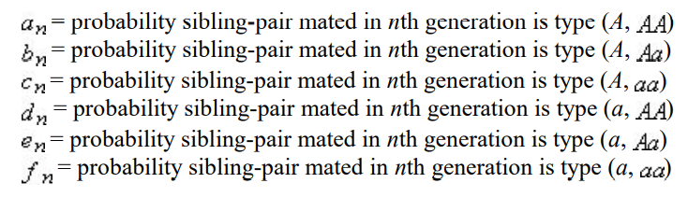
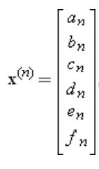
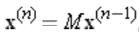
INBREEDING – PART OF X-LINKED INHERITANCE
We begin with a male and female; select two of their offspring at random, one of each gender, and mate them; select two of the resulting offspring and mate them; and so forth Brother-Sister marriage
Original male-female pair can be one of these:
Using Markov’s chain:

Slide 25
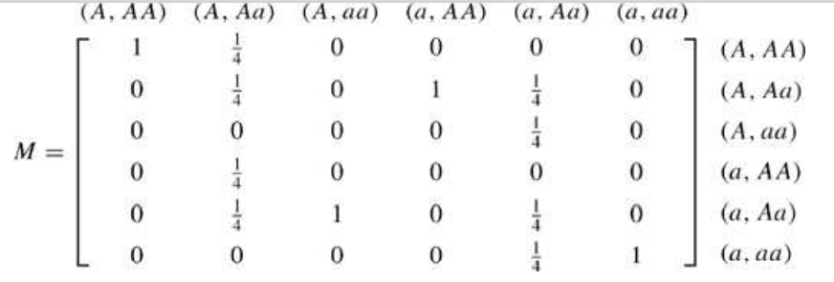
PROBLEM 4
Stochastic matrix –
Suppose the parent pair: A – Aa
Male offspring will be genotype A(50%) and a(50%)
Female offspring will be AA(50%) and Aa(50%)

Slide 26
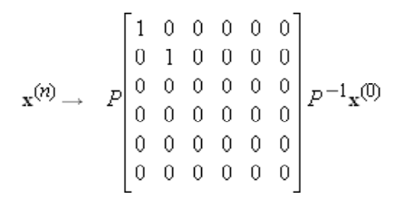
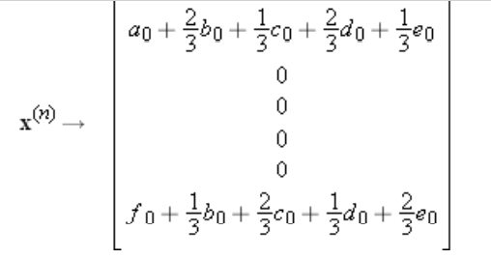
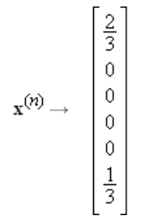
PROBLEM 4
Solving and applying the limits, we get
At the end,
2/3 of the mating pairs will be (A,AA)
1/3 of the mating pairs will be (a,aa)

Slide 27
PART B – GENETIC ALGORITHMS

Slide 28
BACKGROUND
Genetic algorithm – search heuristic inspired by Charles Darwin’s theory of natural evolution
Reflects process of natural selection where the fittest individuals are selected for reproduction in order for reproduction in order to produce offspring of the next generation

Slide 29
BACKGROUND
Natural selection starts with the selection of fittest individuals from a population
Produce offspring which inherit the characteristics of the parents and will be added to the next generation
If parents have better fitness, their offspring will be better than parents and have a better chance at surviving
process keeps on iterating and at the end, a generation with the fittest individuals will be found
Five phases are considered in a genetic algorithm.
Initial population
Fitness function
Selection
Crossover
Mutation

Slide 30
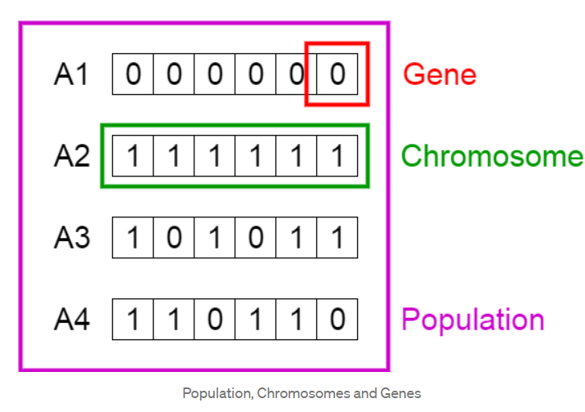
INITIAL POPULATION
Set of individuals(each being a solution to the problem) – Population
Set of parameters/variables – Genes
Genes joined into a string – Chromosome
Set of genes of an individual is represented using a string, in terms of an alphabet
Binary values are used

Slide 31
FITNESS FUNCTION
Determines how fit an individual is
Gives a fitness score to each individual
Probability that an individual will be selected for reproduction is based on its fitness score

Slide 32
SELECTION
Selects the fittest individuals and let them pass their gene to the next generation
Two pairs of individuals(parents) are selected based on their fitness scores
Individuals with high fitness have more chance to be selected for reproduction

Slide 33
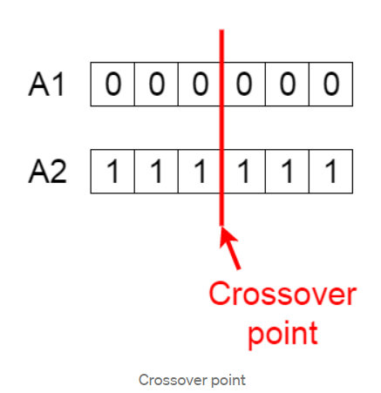
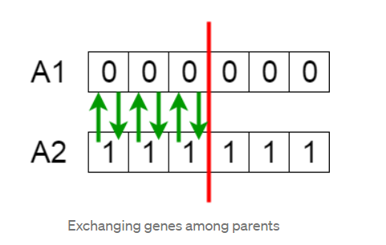
CROSSOVER
For each pair of parents to be mated, a crossover point is chosen at random from within the genes
Offsprings are created by exchanging the genes of parents among themselves until crossover point is reached
New offsprings are added to the population

Slide 34
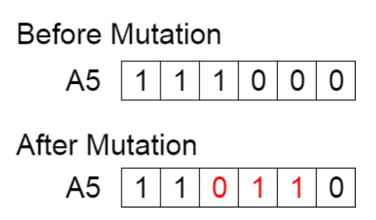
MUTATION
In some new offsprings, some of their genes can be subjected to a mutation with a low random probability
Implies that some of the bits in the bit string can be flipped
Mutation occurs to maintain diversity within the population and prevent premature convergence.

Slide 35
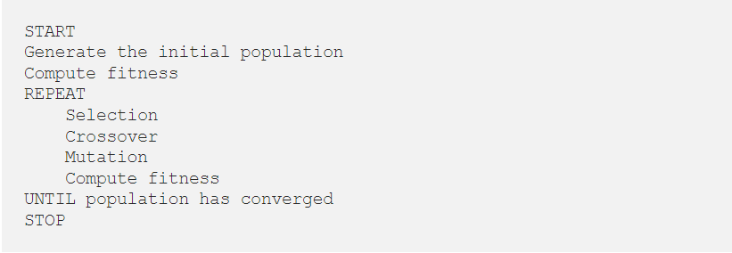
PSEUDOCODE

Slide 36
SCOPE OF IMPROVEMENT
There should be some way to choose the appropriate degree of crossover and mutation operators (ex: Self-organizing GA adapt crossover and mutation operators according to the given problem). It can save computation time that make it faster
Reduce premature convergence problem which suggests that new methods of crossover and mutation techniques are required
GA mimics the natural evolution process => possible scope for simulating the natural evolution process such as human immune system and mutation in viruses

Slide 37
PART C – DNA SEQUENCE PREDICTION

Slide 38
BACKGROUND
Laboratory technique used to determine the exact sequence of bases in a DNA molecule
Developed by Frederick Sanger(1977)
Applications:
Molecular biology
Evolution biology
Metagenomics
Virology
Basic methods:
Maxam – Gilbert sequencing
Chain – termination methods

Slide 39
SLIDE CONTENT COURTESY
https://www.math.ucdavis.edu/~daddel/linear_algebra_appl/Applications/Genetics/genetics/genetics.html
Howard Anton, Chris Rorres - Elementary Linear Algebra with Applications-Wiley (2005)
https://www.youtube.com/watch?v=lydmtraDdXU
https://sites.math.washington.edu/~king/coursedir/m308a01/Projects/m308a01-pdf/kirkham.pdf
https://www.johronline.com/articles/applications-of-linear-algebra-in-genetics.pdf
https://unece.org/fileadmin/DAM/stats/documents/ece/ces/ge.46/2017/2_Genetic_algorithms.pdf

Slide 40
SLIDE CONTENT COURTESY
Introduction to Genetic Algorithms — Including Example Code | by Vijini Mallawaarachchi | Towards Data Science
DNA sequencing – Wikipedia
https://www.youtube.com/watch?v=uXl3_8yVBxI
Illustrating Python via Bioinformatics Examples (hplgit.github.io)

